Slide 1
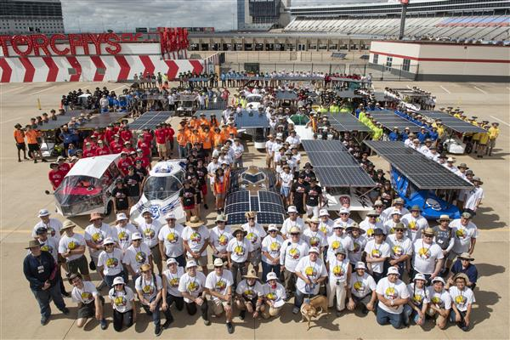
WELCOME TO THE 2020 SOLAR CAR CHALLENGE

Slide 2
Why Participate in the Solar Car Challenge
Develop Teamwork
Problem-Solving and Collaboration
Dedication and Commitment – the “do not quit” attitude
Project-Based Engineering
Learning to deal with Success and Failure
Learn about Budgets and Public Speaking

Slide 3
RACE PLAN FOR 2020 (1) Team Check-In – July 16th Everyone taking part must be there! (2) Scrutineering – July 17-19 including Oral Presentations (3) Stage 1 – July 20 – All teams passing Scrutineering race at Texas Motor Speedway (3) Stage 2 – July 21-23 – top solar cars from each division will race Stage 2. (4) All teams will be Officially Ranked.

Slide 4
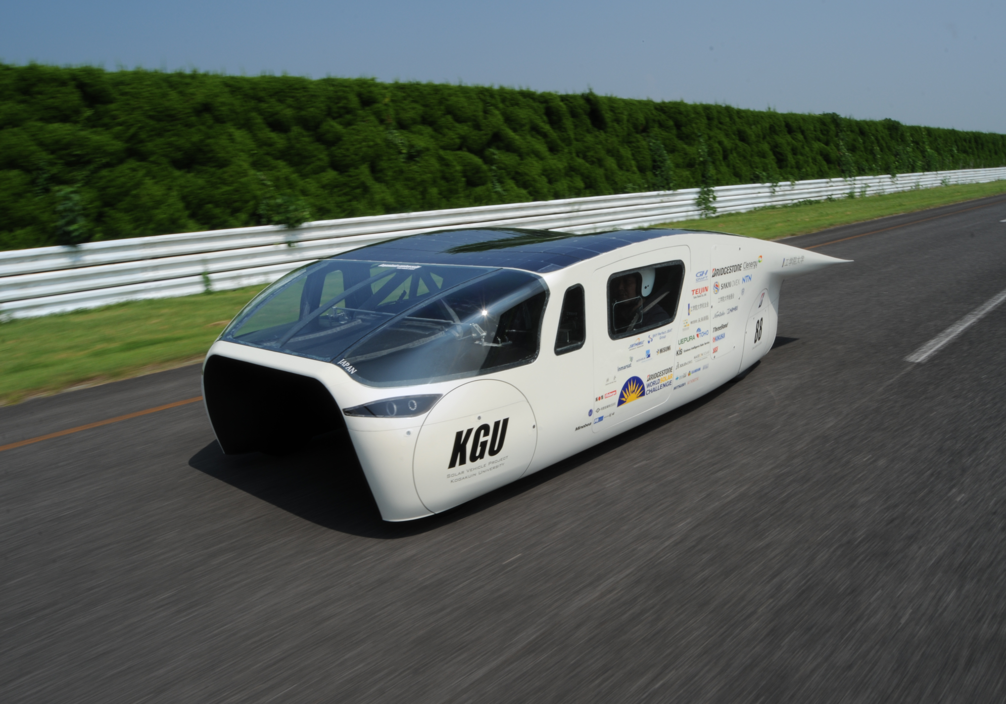
What’s New: Cruiser Division

Slide 5
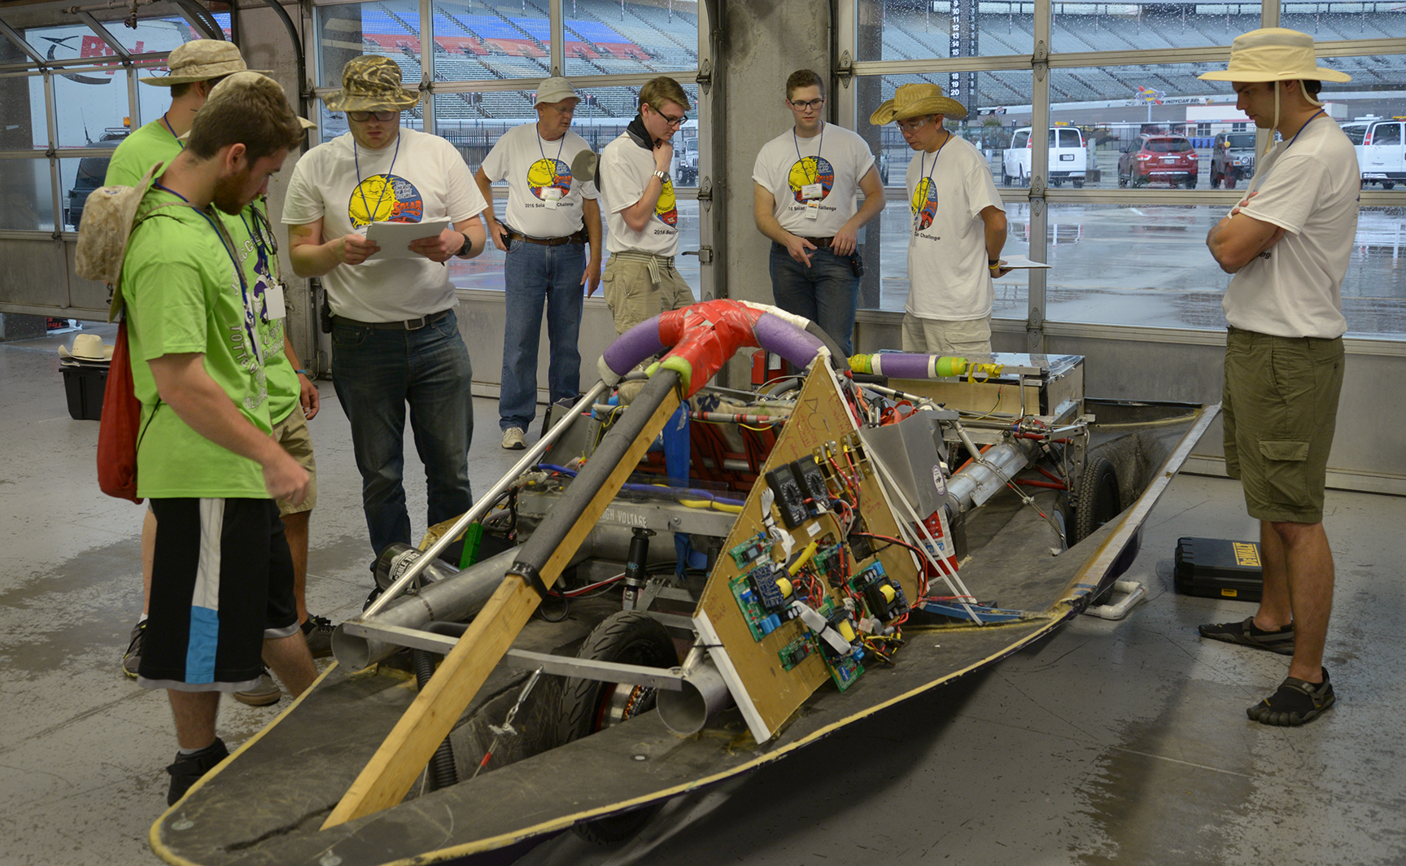
SCRUTINEERING is a 3 Day Event

Slide 6
ORAL PRESENTATION Teams must make an 8-minute oral presentation setting out their project to a panel of judges. Criteria (a) Did the presentation give a full and complete statement about the team's solar car project? (b) Did all the team members participate in the presentation? (c) Did the team make its presentation without the use of notes? (d) Did the team provide visual aids? (e) Did the team scrap book adequately set out the team's progress?

Slide 7
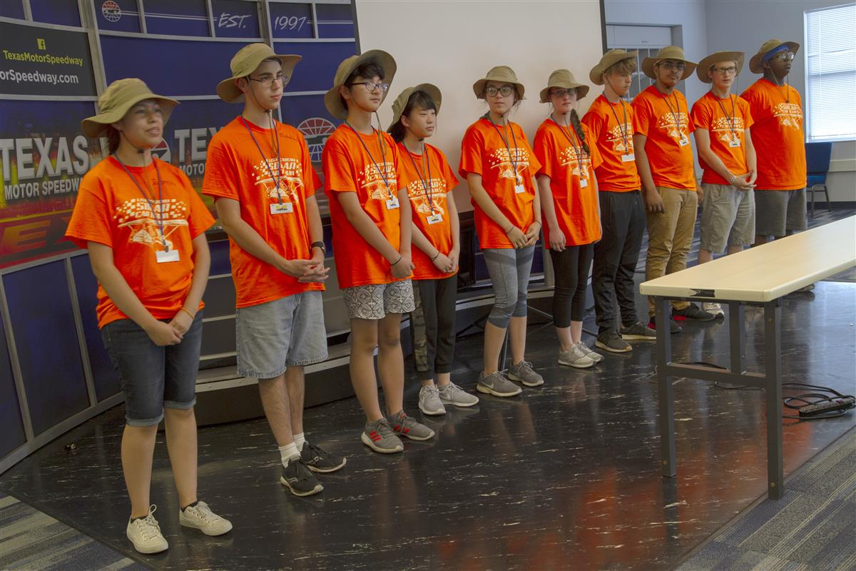
Oral Presentation and Scrapbook Workshop – March 21st scheduled for Saturday, March 21st

Slide 8
STAGE ONE AND TWO

Slide 9
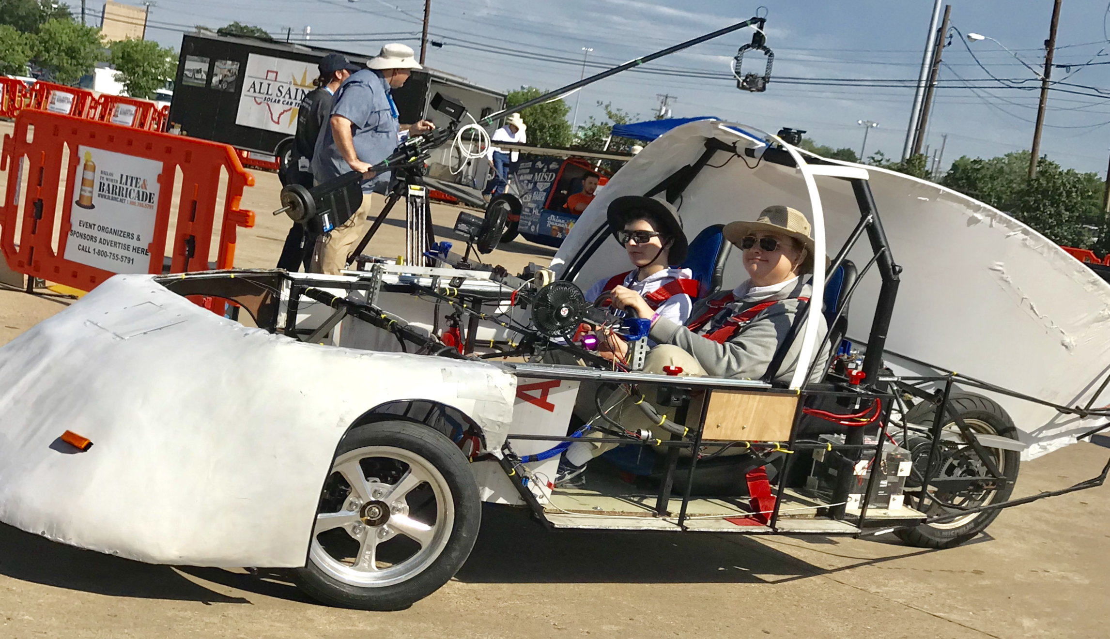
Special Events in 2020 - EarthX

Slide 10
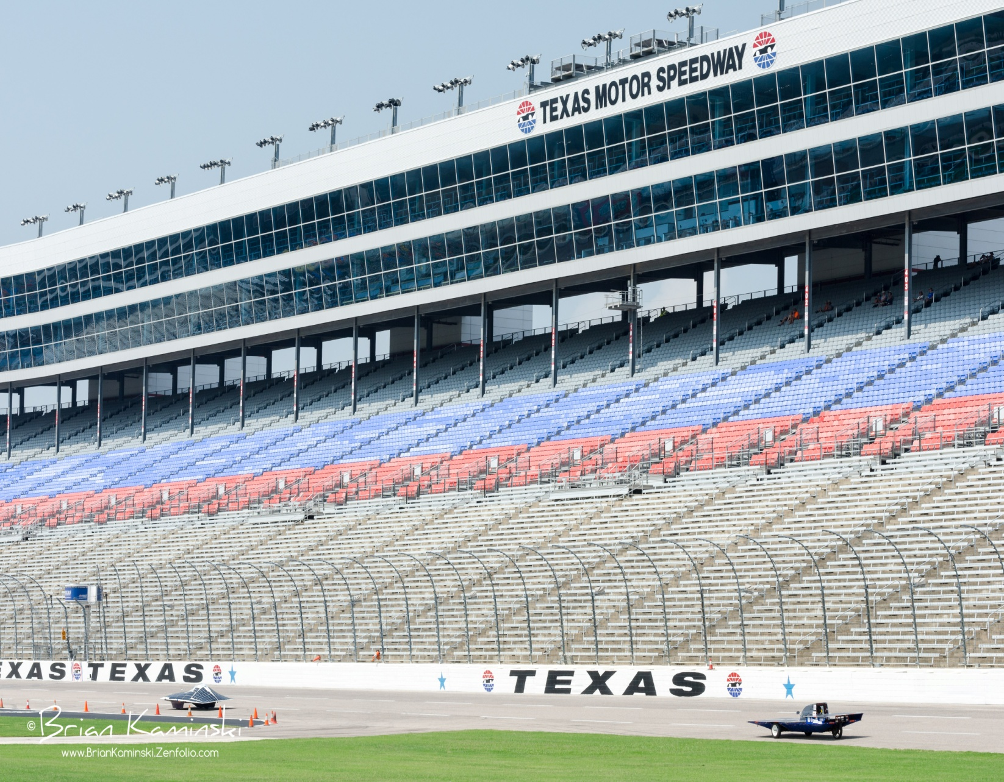
Now, it’s time to start preparing for the 2020 Solar Car Challenge

Slide 11
What is our Philosophy?

Slide 12
This is a Cooperation rather than a Competition

Slide 13
Where do we start?

Slide 14
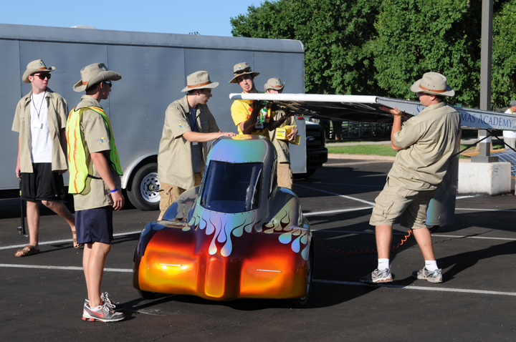
Start with Team-Building

Slide 15
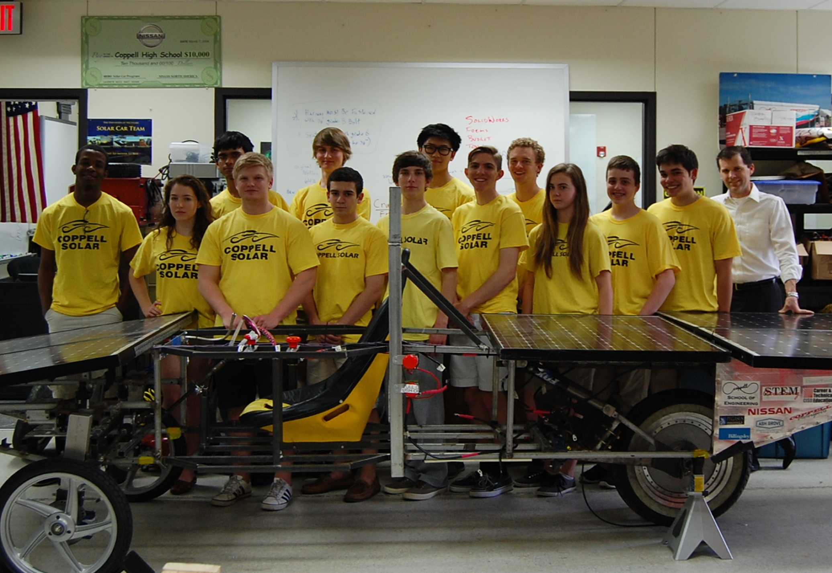
How BIG a team?

Slide 16
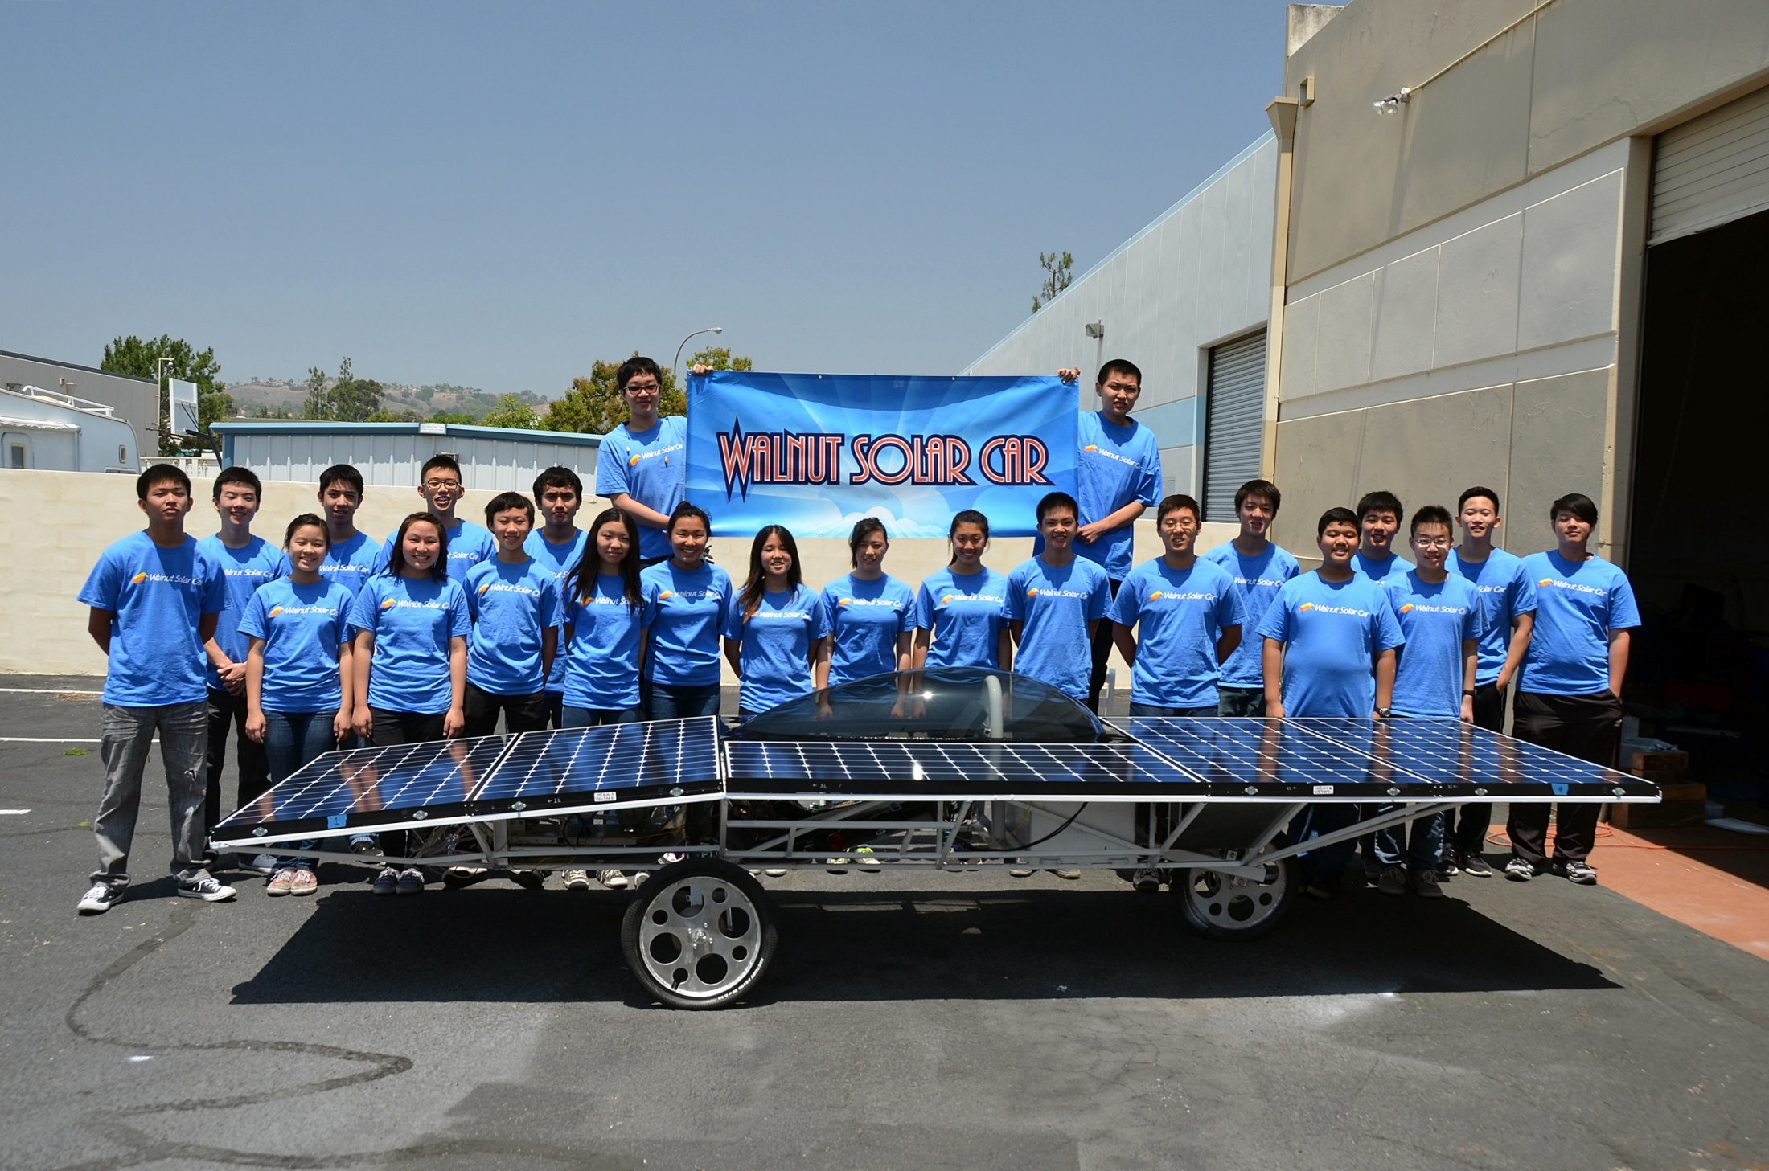

Slide 17
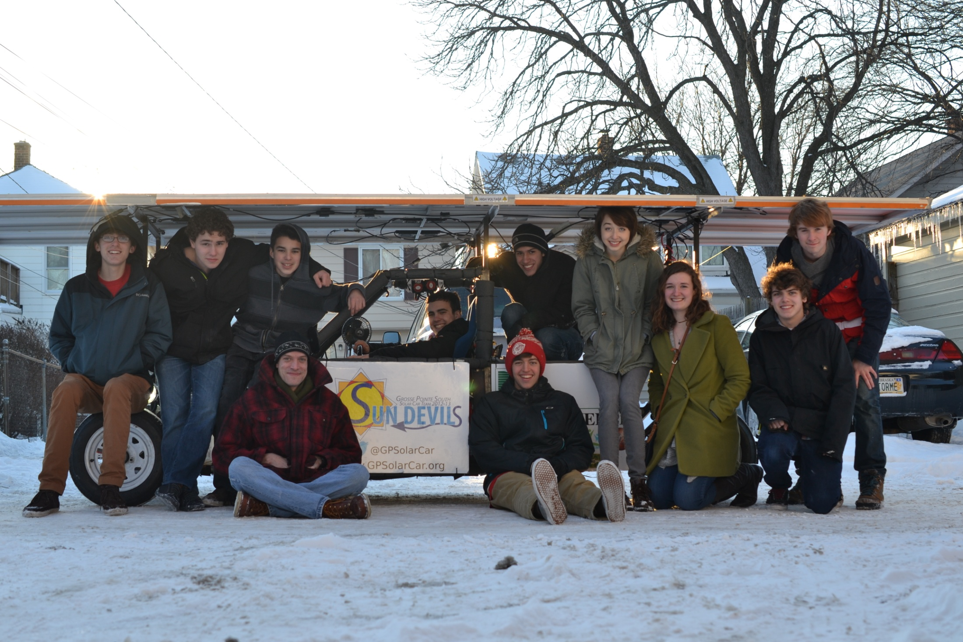

Slide 18
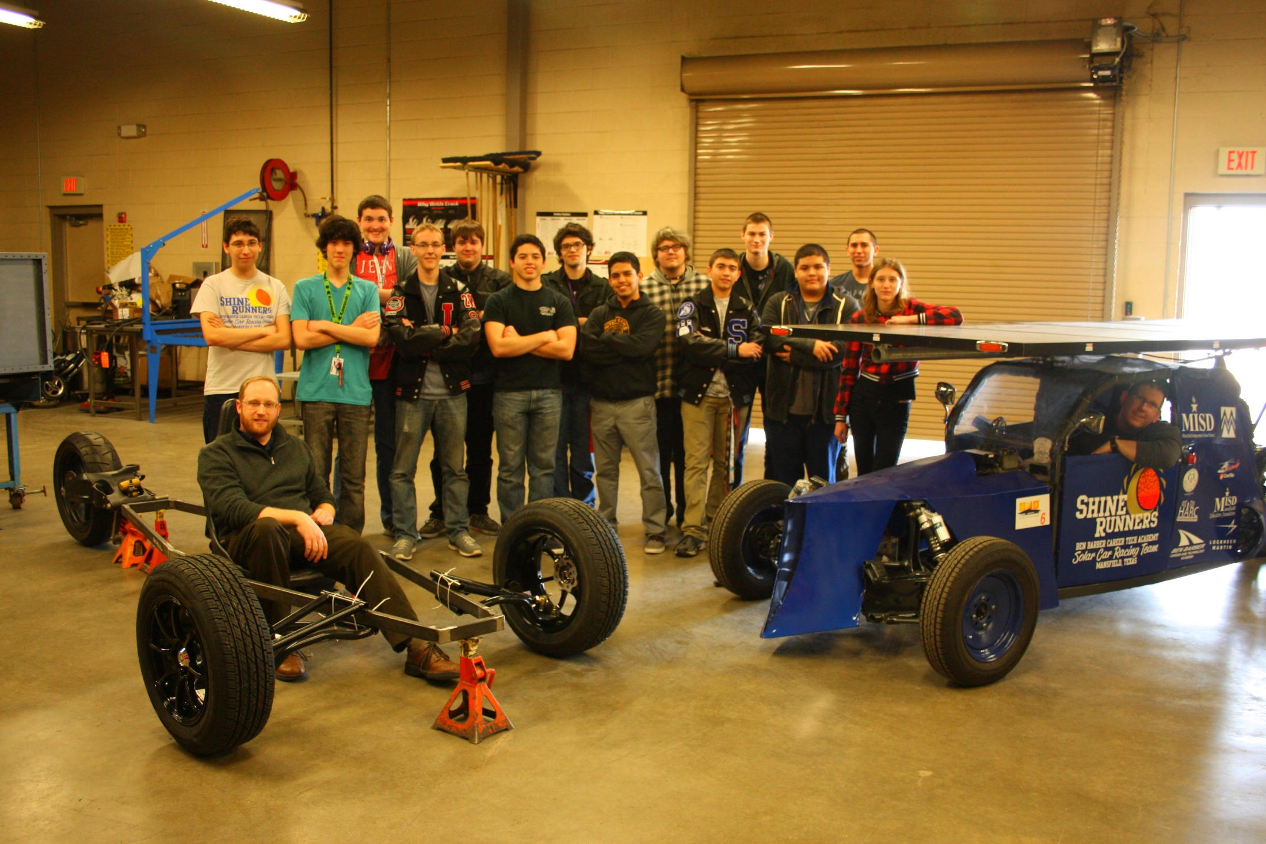

Slide 19
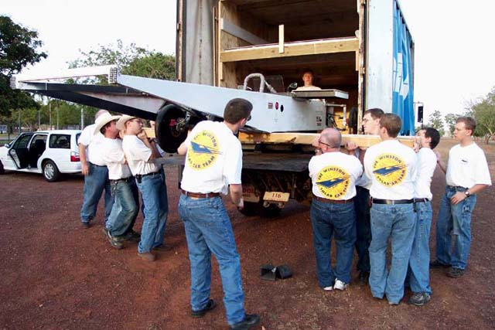
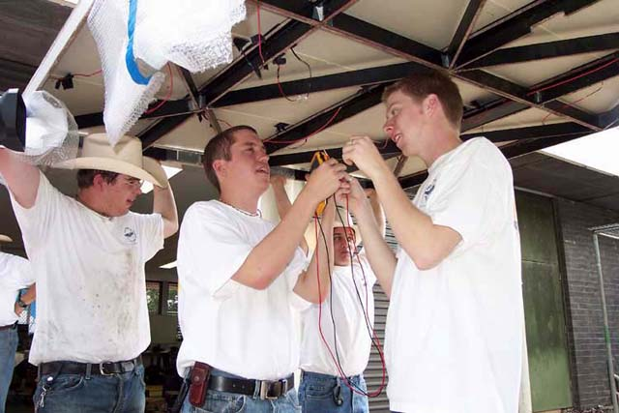
Be sure to have
enough team members to
accomplish the
task involved!

Slide 20
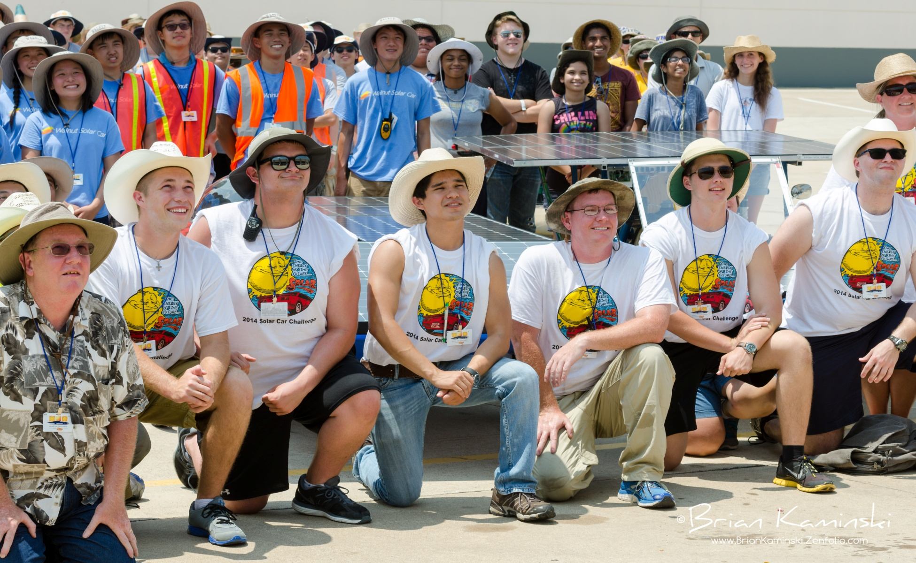
Develop the Role of Team Captain

Slide 21
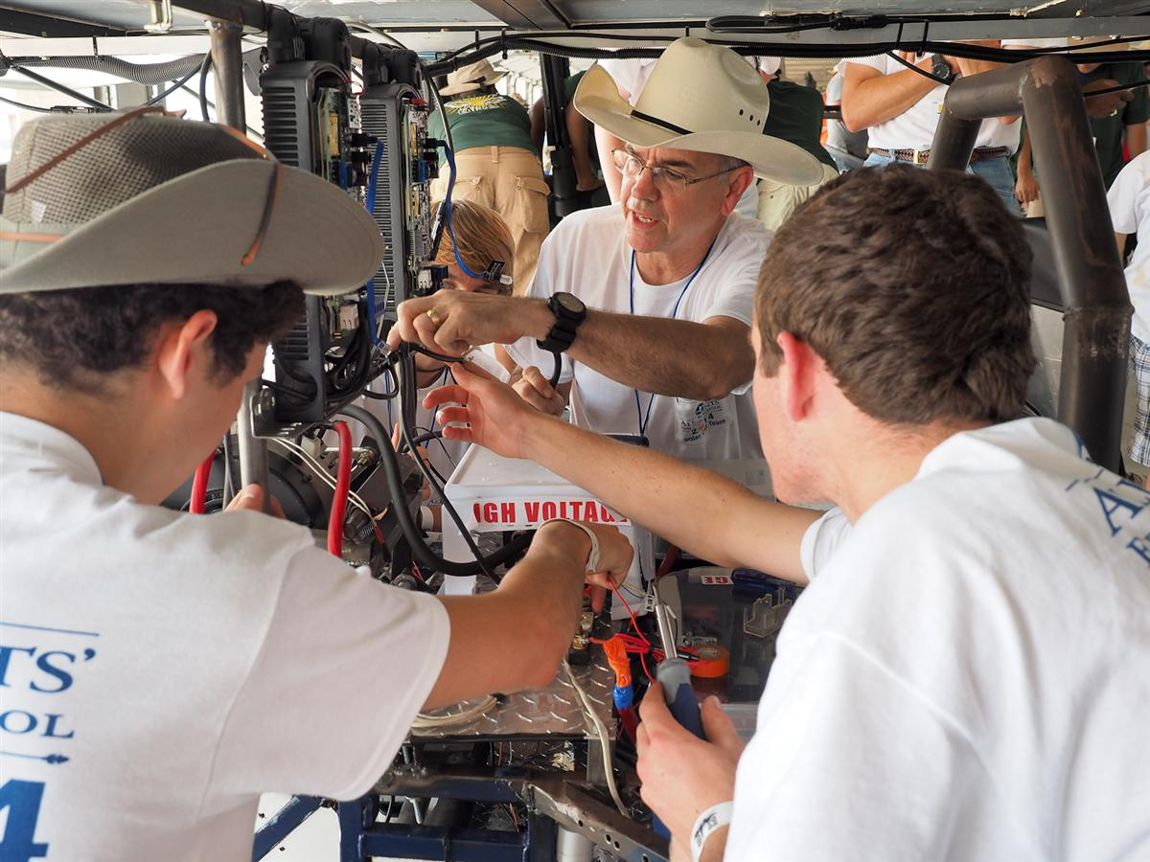
Is the team vested in the project?

Slide 22
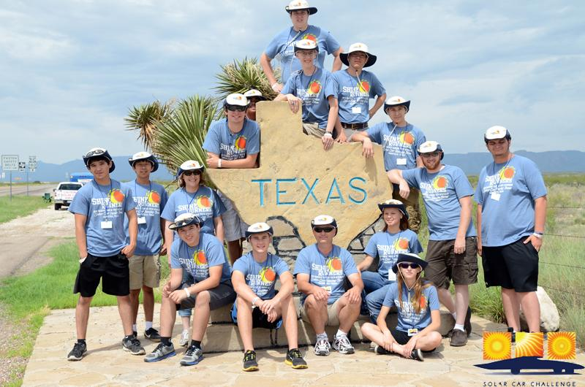
Techniques for developing long term team & parent support

Slide 23
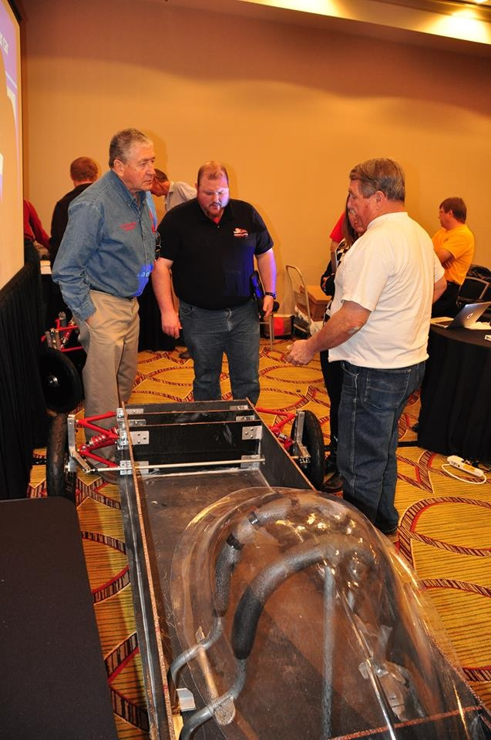
Take Advantage of Workshops
Workshops help you plan your project.
Workshops help you learn the skills to build a roadworthy solar car.
Each team finds its own solution to the problem: building a roadworthy solar car.
Specialty Workshop helps you refine you skills and improve construction techniques.

Slide 24
UPCOMING WORKSHOPS
Saturday, February 15
Build-It Workshop hosted by the
Greenville HS Solar Car Team
Saturday, March 21
Oral Presentation Workshop – How to have a successful oral presentation and scrapbook.

Slide 25
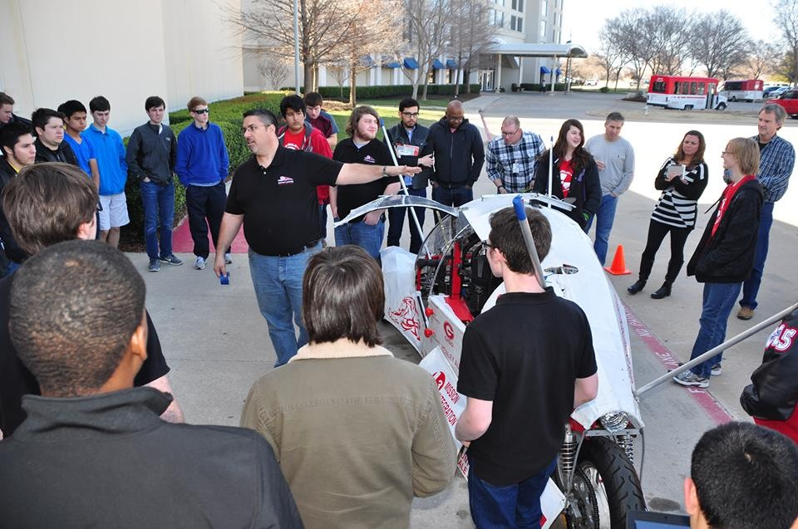

Slide 26
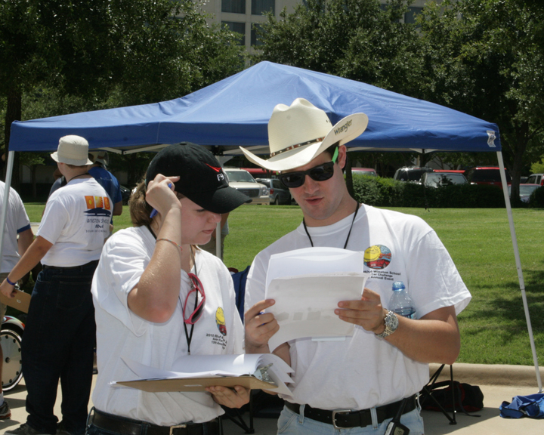
Read the Rules Together (many times)

Slide 27
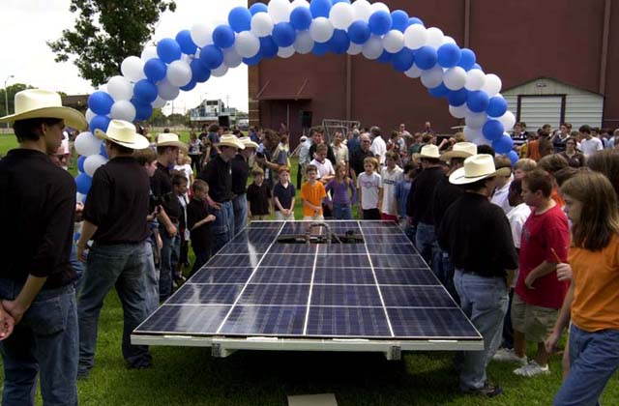
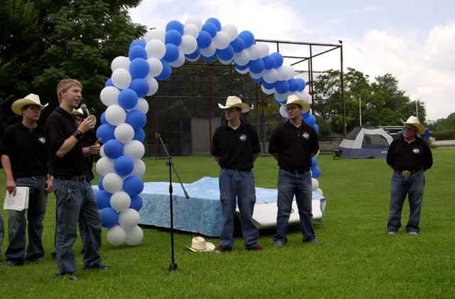
The importance of the Team being a part of fundraising

Slide 28
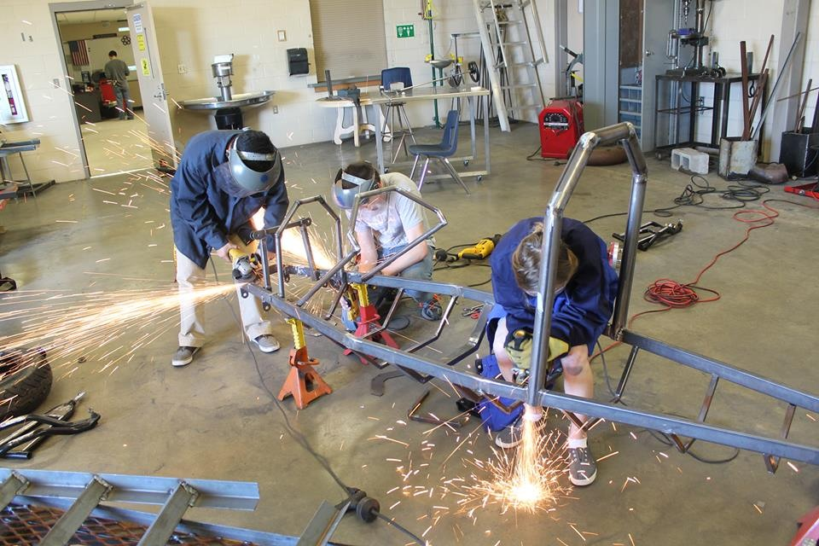
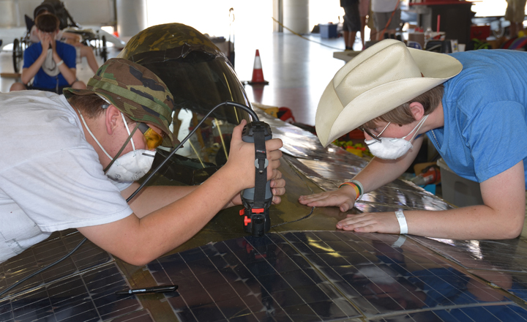
The importance of building skills

Slide 29
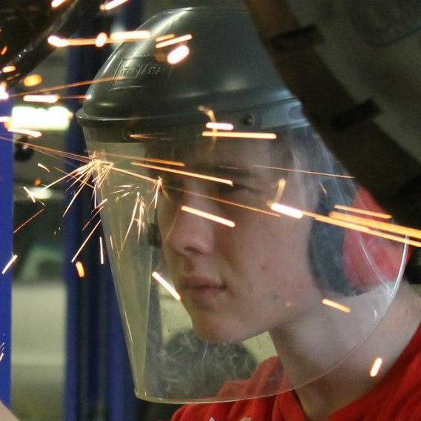

Slide 30
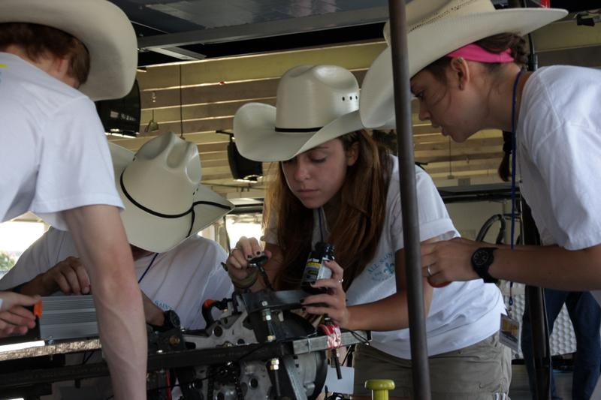

Slide 31
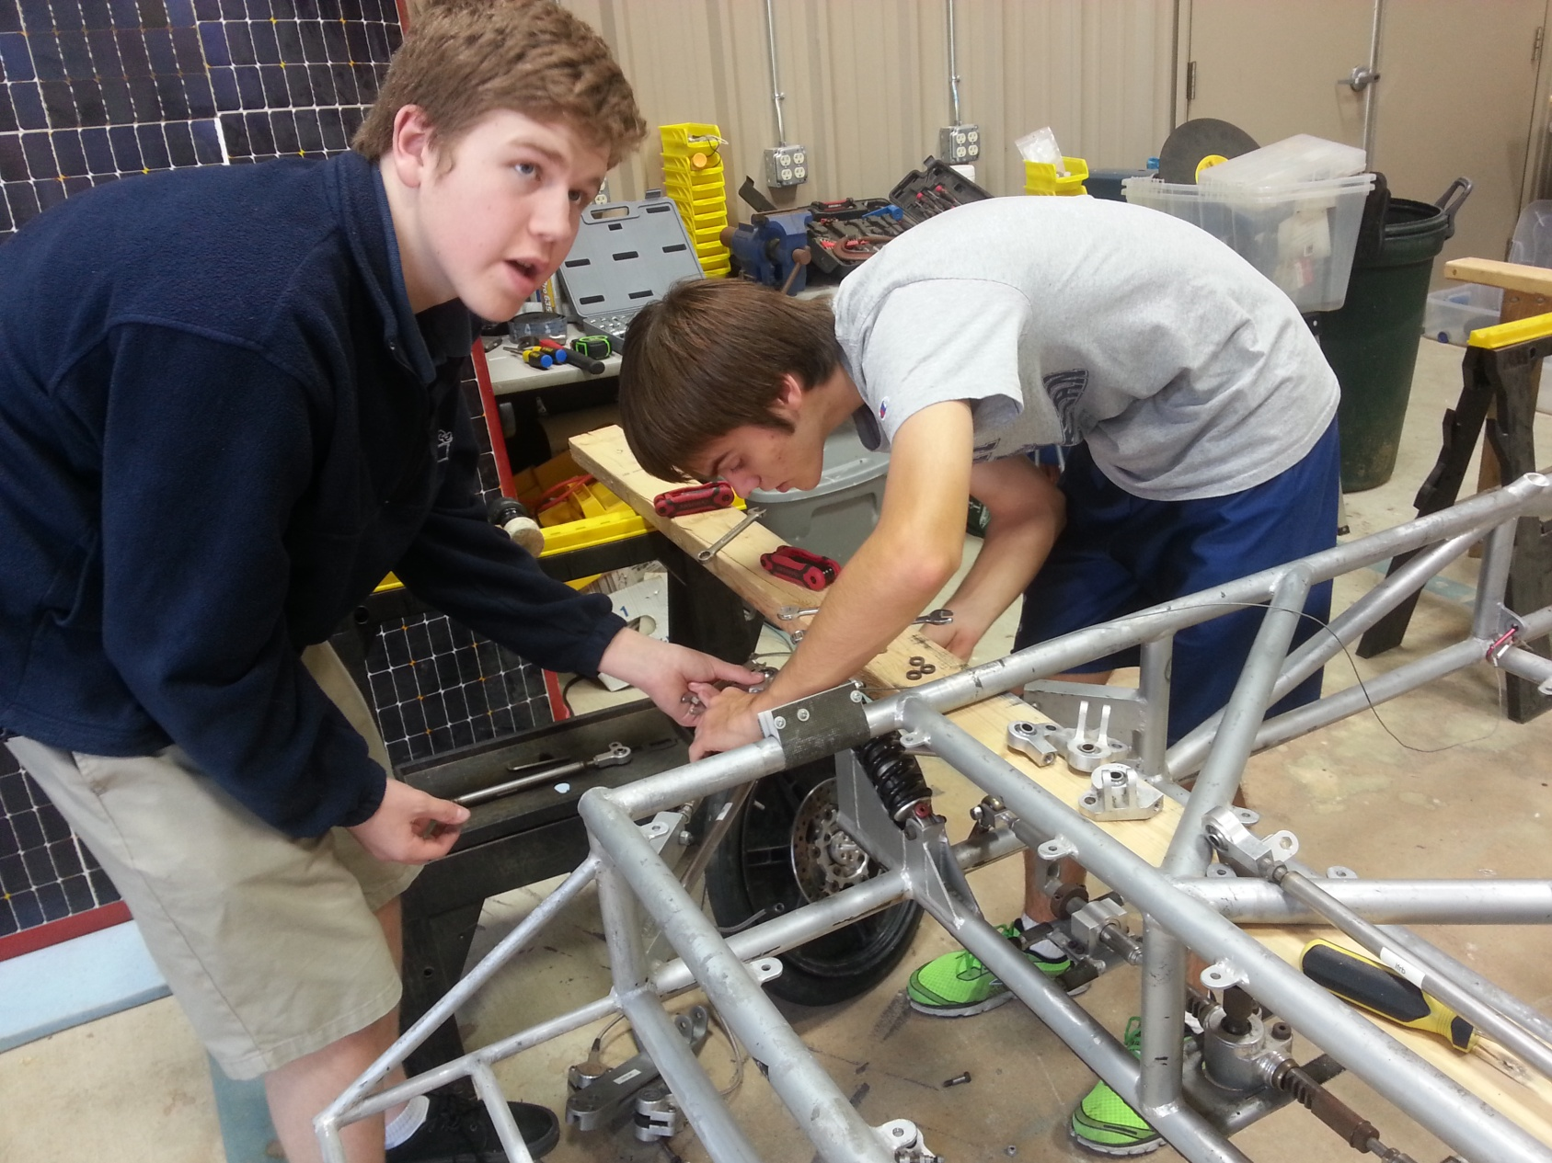
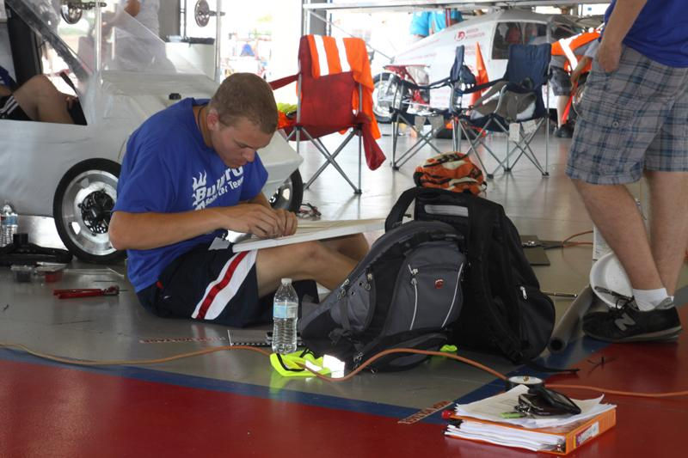

Slide 32
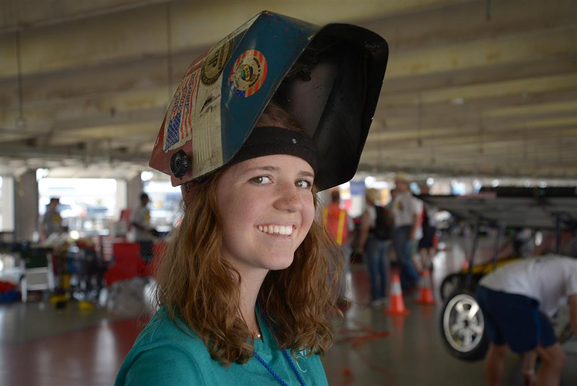

Slide 33
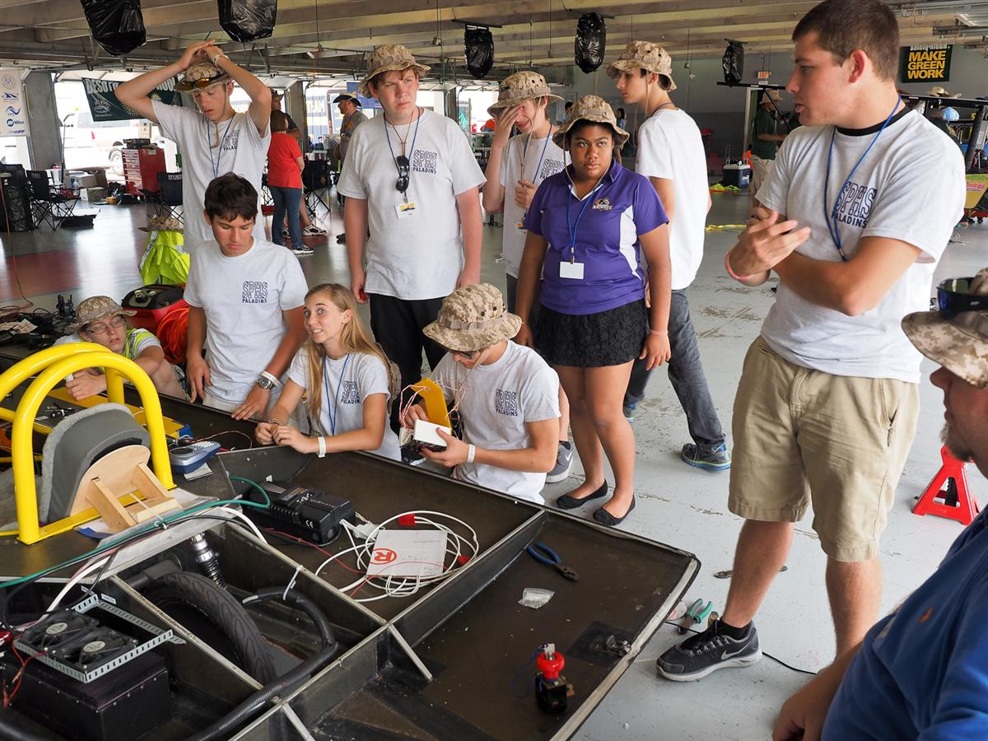
Importance of Goal-Setting and following a Timeline

Slide 34
TIMELINE
Plan Develop Fundraising Buy Build Re-Engineer Test Race Post And Promo Car Race
Design Materials Eval
____________________________________________
Sept Early Oct Oct Nov Dec - Mar Apr - May July Aug

Slide 35
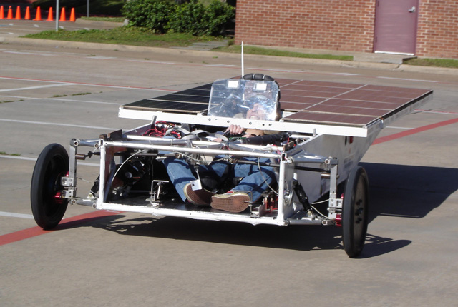
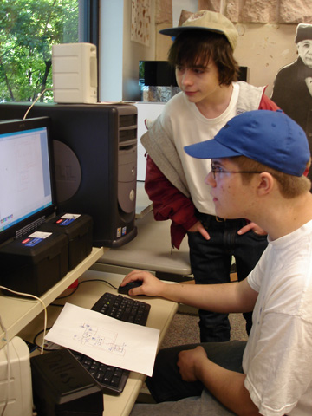
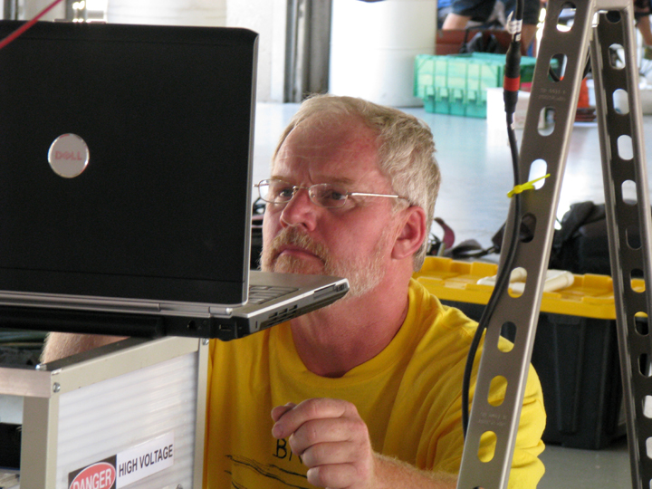
Importance of Testing

Slide 36
The Reality of Testing
The three Teams that did not pass Scrutineering in 2019 never tested their vehicles.
Recommendation: Put 500 miles on your solar car before you ever get to the Race.
You want to “break” the car at home . . . Not at the Race.

Slide 37
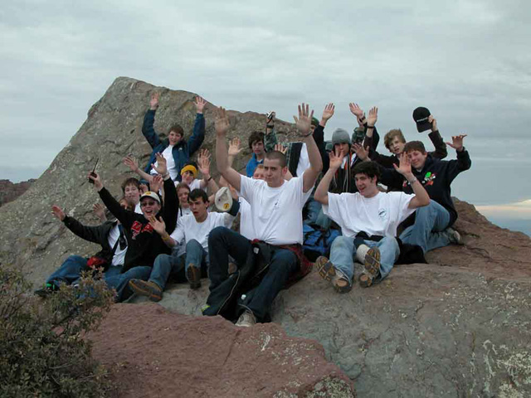
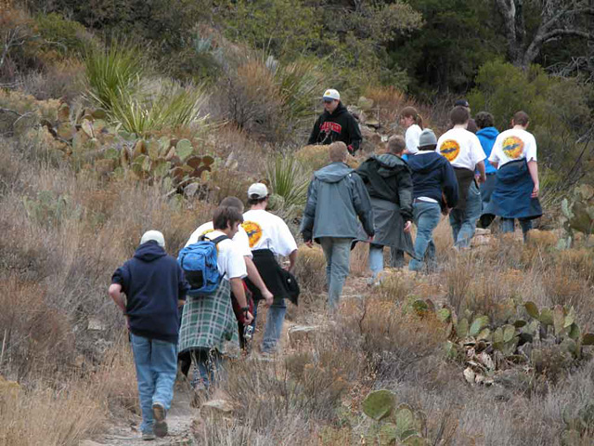
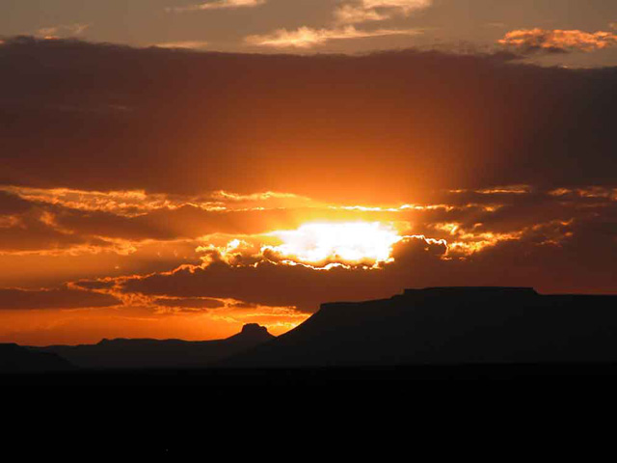
Post-Race Evaluation

Slide 38
WHY THE SOLAR CAR CHALLENGE?
Because every High School and STEM Academy needs a TOP Project for their
Project Based Learning

Slide 39
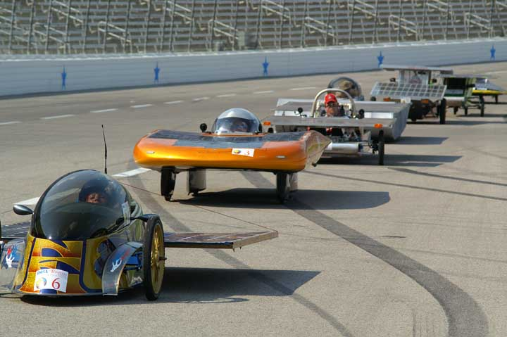
Yes, BY 23%
IS IT WORKING?

Slide 40
